Slide 1

NutriNest: Smart & Healthy Dry Fruits Marketplace
A Capstone Project built on the MERN Stack, demonstrating full-stack e-commerce development capabilities.
Presented by : Abhigyan

Slide 2




Project Overview: Building a Niche E-Commerce Solution
Problem Solved
Why E-Commerce?
Created a streamlined platform to easily access high-quality, specialty dry fruits, addressing the complexity of sourcing premium healthy snacks.
Tapping into the growing online market for health and wellness products, offering convenience and transparency in product information.
Core Project Goals
Full-Stack Integration
Secure Functionality
Scalable Backend
Successfully integrate all components of the MERN stack (MongoDB, Express, React, Node.js).
Implement robust user authentication, authorization, and secure payment processing flow.
Develop a functional Admin Panel for efficient product and order management.

Slide 3



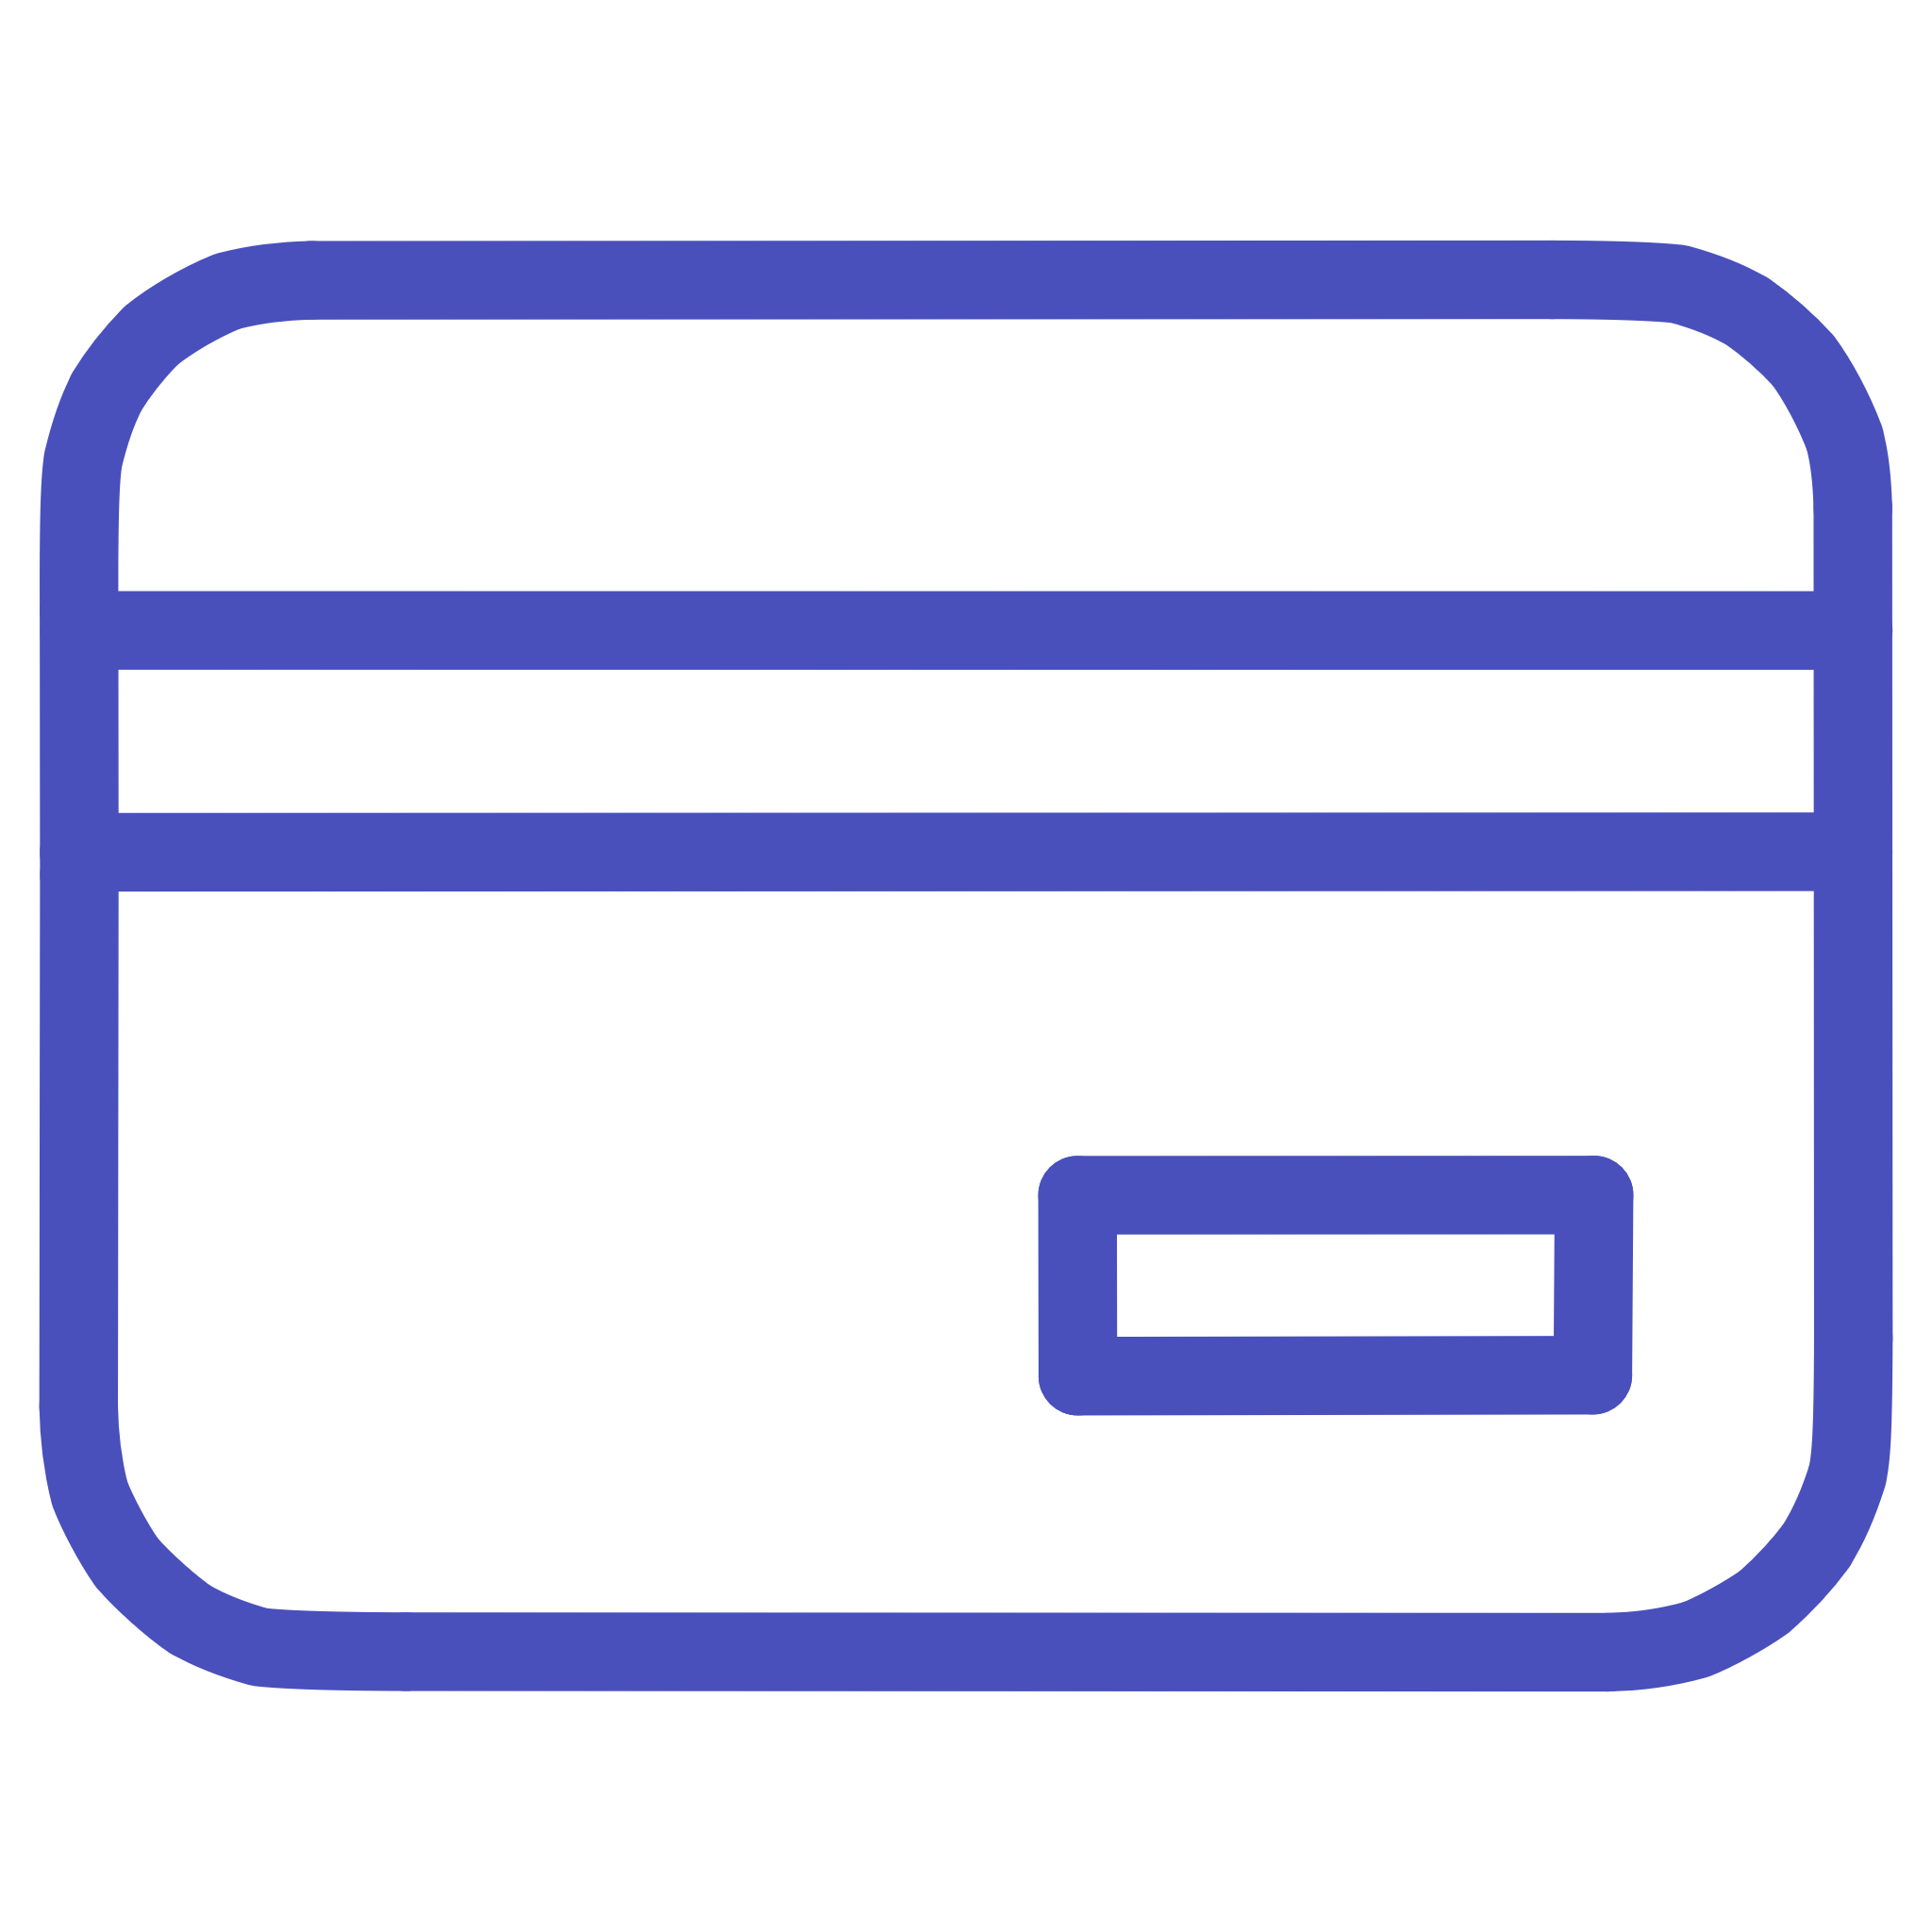

Core Feature Breakdown
User Authentication
Secure login and registration using hashed passwords and token management.
Cart & Wishlist
Dynamic cart management with quantity updates and persistent wishlist storage.
Secure Checkout
Seamless integration with a payment gateway (Razorpay) for transaction handling.
Admin Panel
Dedicated interface for managing products, categories, and viewing orders.

Slide 4
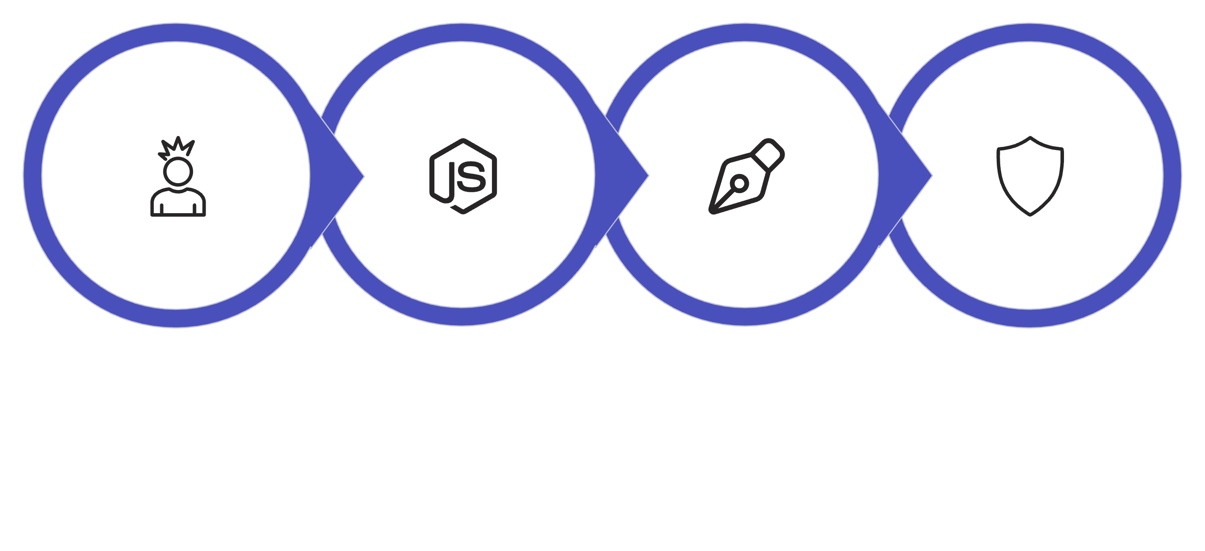

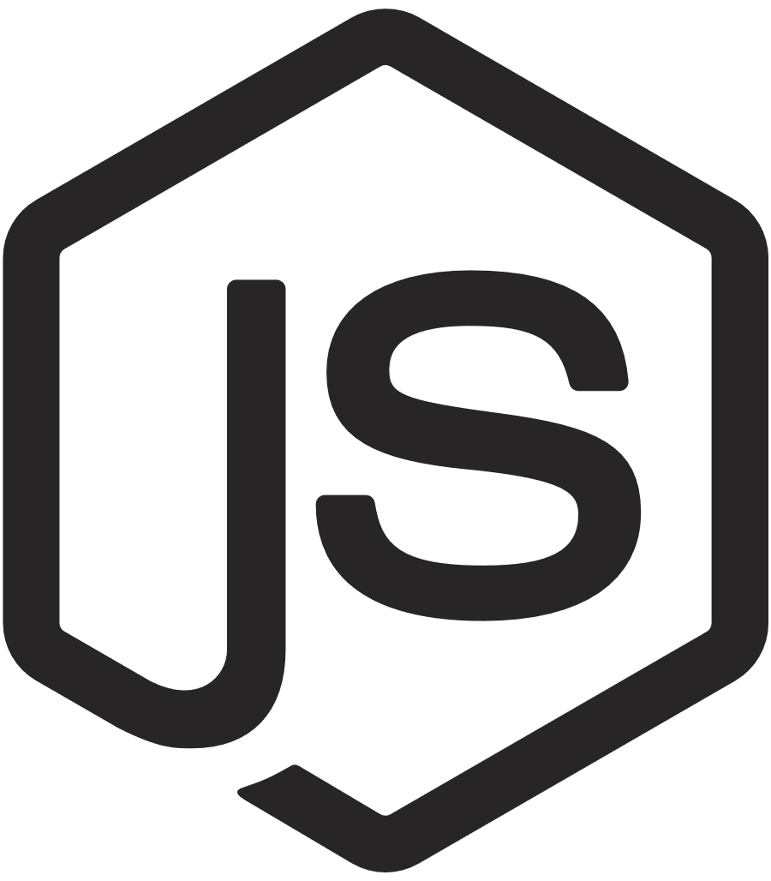


Technical Architecture: The MERN Stack
JWT Authentication
React Frontend
Node.js/Express
MongoDB Database
Component Details
Client-Side (Frontend)
Server-Side (Backend)
React (Functional Components & Hooks)
Node.js with Express framework for routing and middleware.
Responsive design for optimal viewing across devices.
JWT (JSON Web Tokens) for stateless authentication.
Deployment utilized Vercel for the front end and Render for the back end, ensuring a production-like environment for testing.

Slide 5


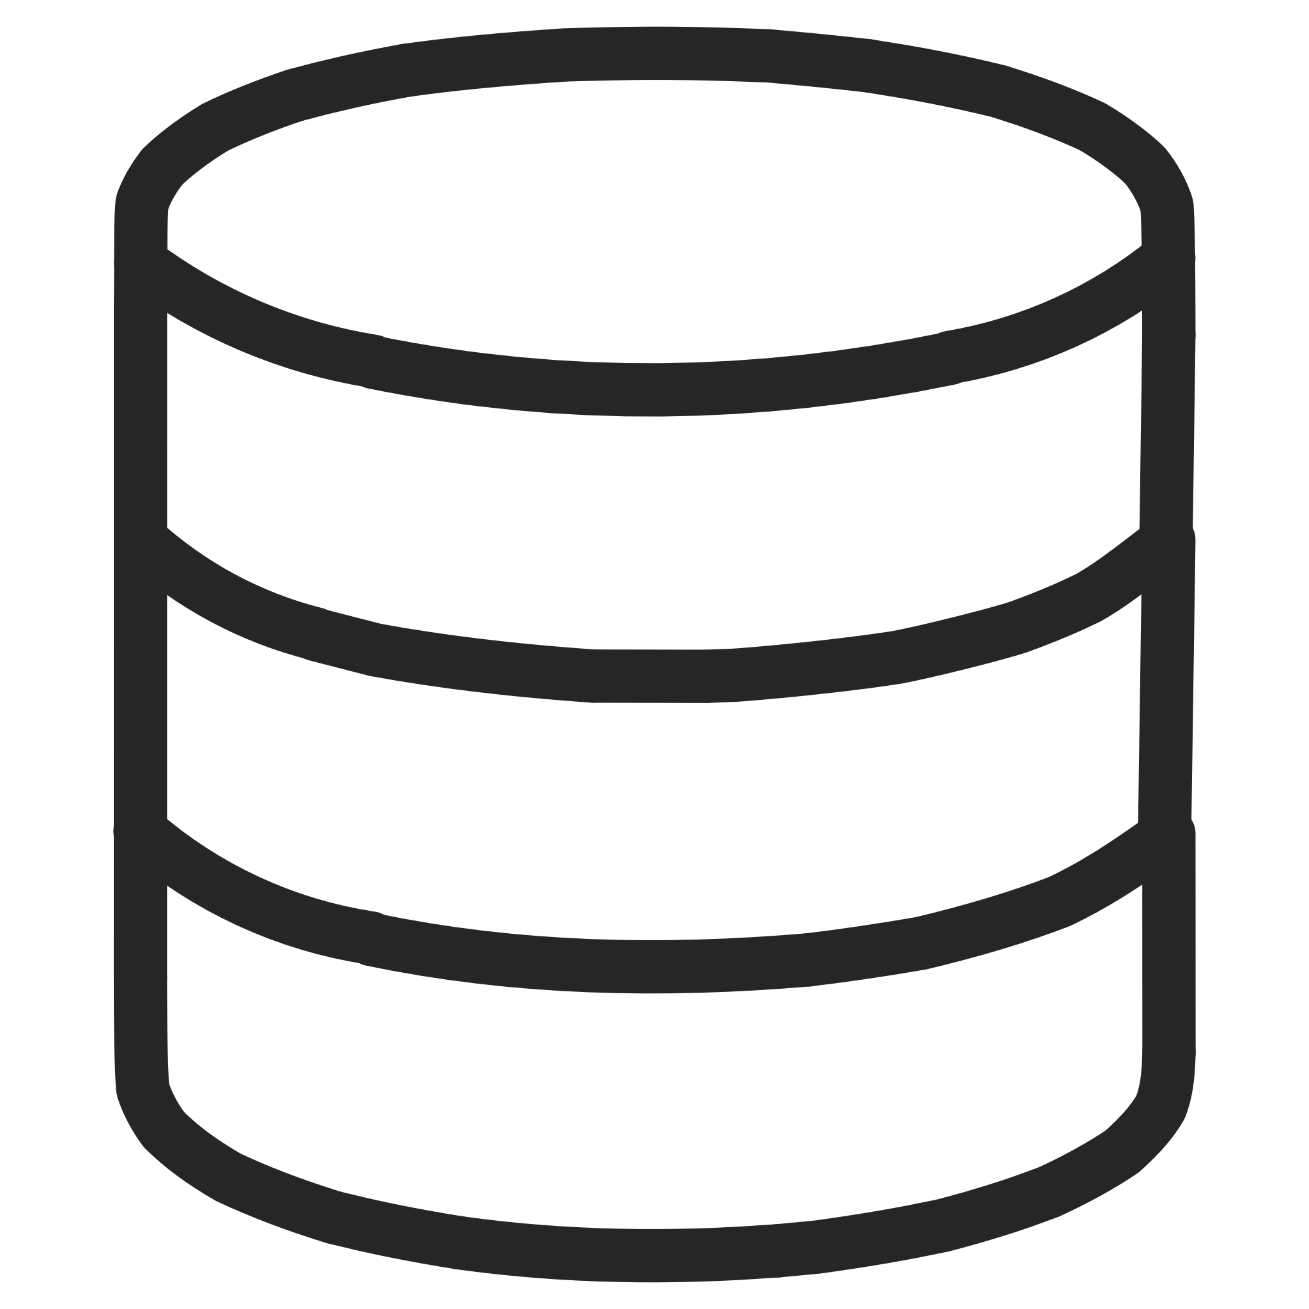

Key Learning Outcomes from the Project
NutriNest served as a crucial bridge between theoretical knowledge and real-world application, solidifying key full-stack development skills.
MERN Stack Proficiency
Deep practical understanding of how MongoDB, Express, React, and Node.js communicate effectively.
State & API Handling
Mastering global state management and handling complex asynchronous API calls (GET, POST, PUT, DELETE).
Database Design
Designing optimized NoSQL schemas (MongoDB) for products, users, and orders, including relationship modeling.
Deployment Pipeline
Gaining experience in preparing code for production, managing environment variables, and deploying to cloud platforms.

Slide 6


Technical Challenges Encountered
Developing a complex application like NutriNest involved navigating several common full-stack hurdles, demanding structured debugging.
Cross-Origin (CORS) Issues
Initial difficulty connecting the React frontend running on one port to the Node/Express backend on another.
Inconsistent API Status Codes
Debugging various HTTP status codes (401 Unauthorized, 405 Method Not Allowed) during route testing.
Asynchronous Operations
Managing promises and async/await syntax to ensure smooth data retrieval without breaking the application state.
Environment Configuration
Securing and correctly setting up environment variables (API keys, database URI) for deployment.

Slide 7

Resolution Strategies: Debugging and Optimization
Streamlining API Routes
Refactored route handlers to strictly adhere to RESTful principles, ensuring the correct HTTP method (GET, POST, PUT, DELETE) was used for each action.
Robust Token Authentication
Implemented middleware to validate JWTs on protected routes, effectively solving 401 Unauthorized errors and ensuring data security.
Improved Data Validation
Introduced stricter backend schema validation to prevent malformed data from reaching the database, reducing state mismatch bugs.
Advanced Error Handling
Established centralized error handling practices on both frontend and backend to provide clear user feedback and prevent application crashes.

Slide 8
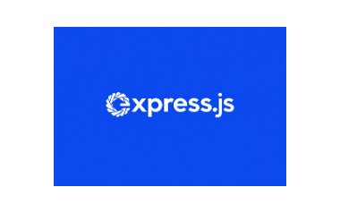
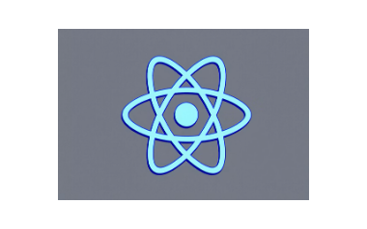
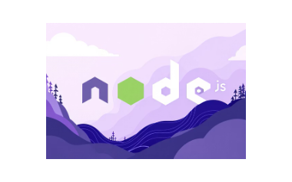


Development Toolkit
The project was executed using a focused set of modern industry tools for efficient development, testing, and deployment.
Razorpay integration was critical for simulating real-world transaction processing, providing experience with third-party payment APIs.

Slide 9

Version Control and Collaboration with Git/GitHub
Effective use of version control was vital for managing the project's evolution, tracking changes, and maintaining a stable codebase.
git init
Initializes a new Git repository in the project directory.
git add . & git commit
Stages and records local changes with meaningful commit messages.
git push
Uploads local commits to the remote GitHub repository.
git pull
Fetches and merges changes from the remote repository, ensuring synchronization.

Slide 10



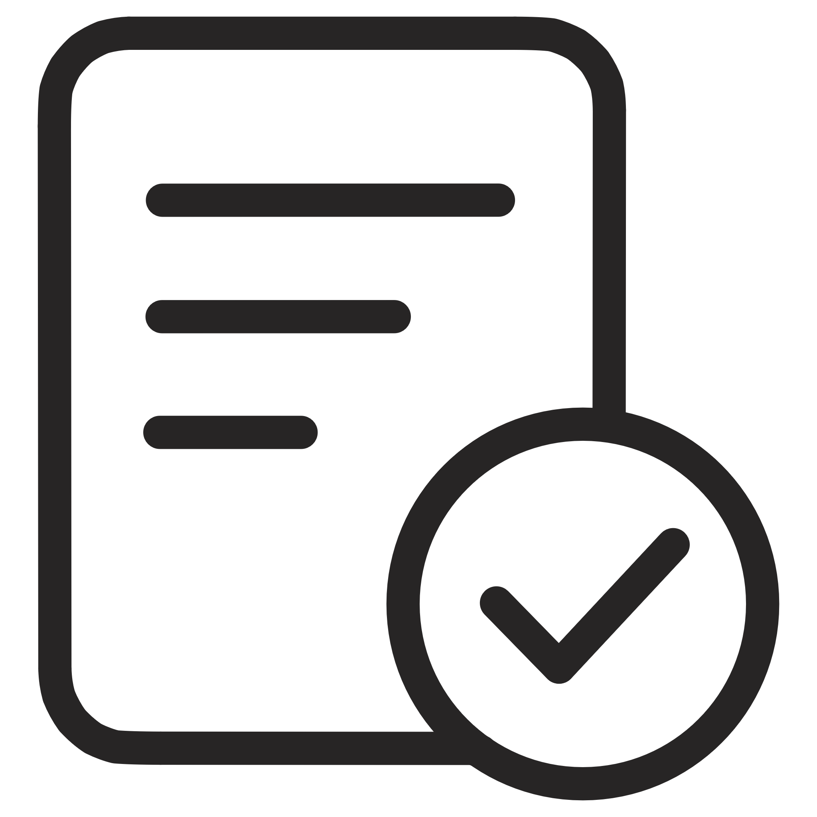

Future Growth: Strategic Enhancements
The NutriNest platform is designed for future expansion, with several key features identified to enhance user experience and business insights.
Mobile App Version
Development of a dedicated mobile application using React Native or similar technology.
Performance Optimization
Implementing caching, CDN integration, and code splitting for faster load times.
Reviews & Ratings
User-generated content module to build trust and inform purchase decisions.
Advanced Order Tracking
Real-time updates and detailed shipment status for customers.
Admin Analytics
Integration of data visualization tools for sales, inventory, and user behavior analysis.

